Slide 1

Data Analysis Essentials
Cornerstone Project
Indian Paper Leaks Data Analysis (2004-2026)
Presented by
N .Vedha Sri (25B11CS659)
Guide: Mr.K.Ashok Teja, Assistant Professor, CSE Dept.
Department of Computer Science and Engineering

Slide 2




Contents
• Problem Understanding
• Introduction
• Current Approach & Limitations
• Proposed Approach
• Dataset Description
• Requirements
• Methodology
• Data Visualization
• Key Insights & Analysis
• Implementation Workflow
• Conclusion

Slide 3
PROBLEM STATEMENT
Paper leaks are a serious concern in India, but raw paper-leak records are difficult to understand without structured analysis. This project uses Pandas to analyse paper-leak incidents from 2004 to 2026 through data loading, acquisition and filtering, extraction, validation and cleaning, aggregation, analysis, visualization, and results interpretation. It identifies year-wise trends, major areas and exams, leak status, UPA–NDA era differences, affected aspirants, arrests, and convictions to generate meaningful insights.

Slide 4
Introduction
Paper leaks are a major concern affecting examinations and students across India.
Paper-leak data contains useful information about incidents, examinations, and their impact.
Raw records may contain missing values, duplicates, and inconsistent information.
Pandas helps load, extract, validate, clean, and organize the dataset.
This project analyses paper-leak incidents from 2004 to 2026 using structured data analysis.
Visualizations help identify trends, patterns, and meaningful insights from the analysed data.

Slide 5
Current / Manual Approach
Paper-leak information is stored in raw CSV records.
Manually checking a large number of records is time-consuming.
Finding year-wise, area-wise, and exam-wise patterns is difficult.
Missing values and inconsistent records may go unnoticed.
Raw data is difficult to understand without proper visualizations.
Manual analysis makes it difficult to identify important trends and patterns.

Slide 6
Limitations of Manual Analysis
Manual analysis is time-consuming and difficult to manage.
Large paper-leak datasets are difficult to process manually.
Missing or inconsistent records can affect analysis accuracy.
Year-wise and category-wise patterns are difficult to identify manually.
Trends in arrests, convictions, and affected aspirants are hard to compare.
Manual processing increases the chance of human errors.
Limited analysis makes it difficult to obtain meaningful insights.

Slide 7
Proposed Approach
Data loading and initial exploration
Data acquisition and filtering
Data extraction and selection
Data validation and cleaning
Data aggregation and representation
Data analysis of trends and patterns
Data visualization using bar charts, pie charts, and line charts
Results interpretation and key insights

Slide 8
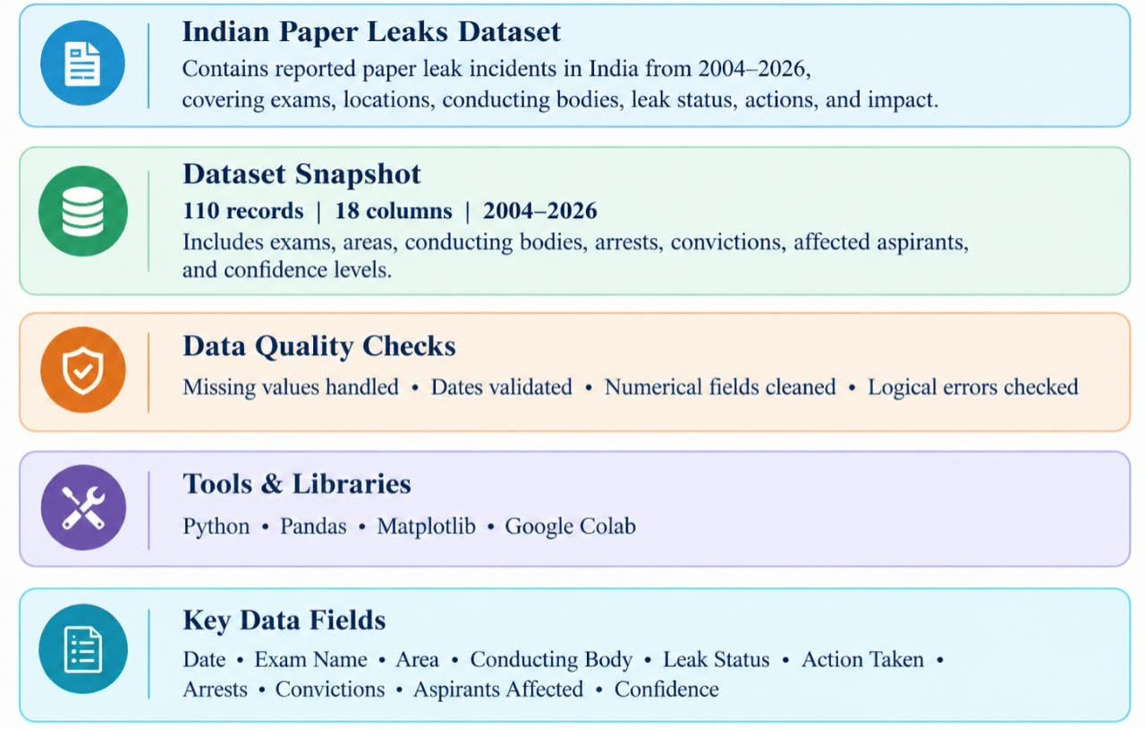
DATASET DESCRIPTION

Slide 9
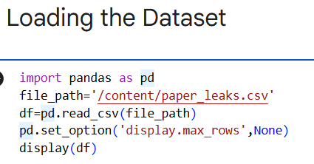
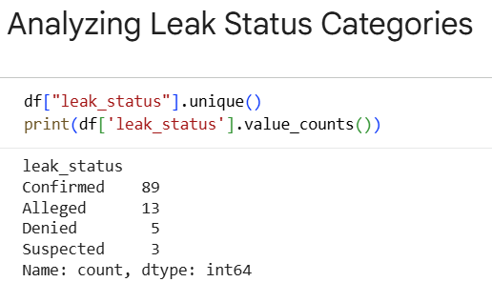
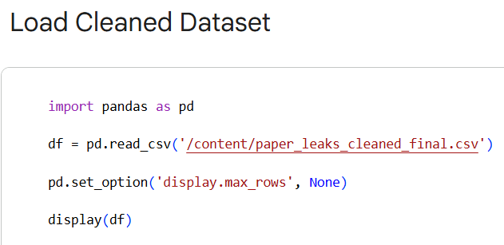
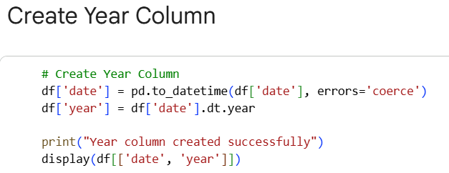
REQUIREMENTS
Tools Used
•Python • Pandas • Matplotlib • Google Colab

Slide 10
METHODOLOGY
Module 1 –Data Loading & Reading
Import required Python libraries.
Load the paper-leak dataset using Pandas.
Module 2 – Data Acquisition & Filtering
Select the required records from the dataset.
Filter data based on leak status and body type.
Module 3 – Data Extraction
Select important columns from the dataset.
Extract relevant paper-leak information.
Module 4 – Data Validation & Cleaning
Check for missing values.
Validate data types and records.

Slide 11
METHODOLOGY
METHODOLOGY
Module 5 – Data Aggregation & Representation
Group the data based on required categories.
Represent the summarized data in a structured form.
Module 6 – Data Analysis
Analyse year-wise paper-leak incidents.
Identify important patterns and trends.
Module 7 – Data Visualization
Create bar charts and pie charts.
Use line charts to show trends.
Module 8 – Results & Interpretation
Interpret the analysed results.
Summarize the key findings and insights.

Slide 12
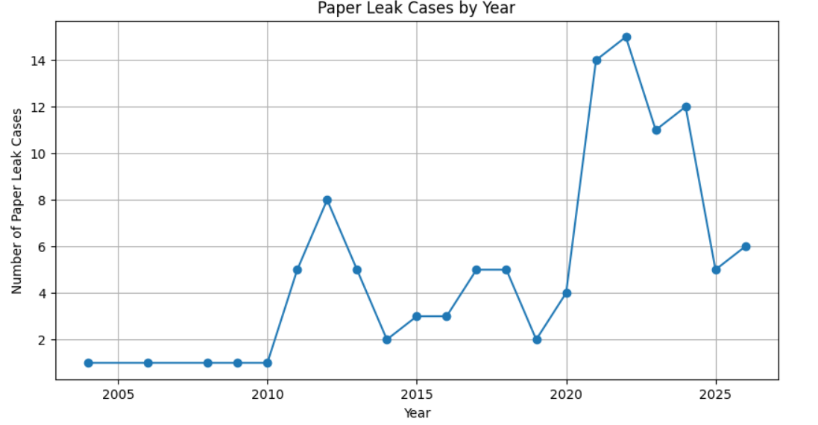
Data Visualization

Slide 13
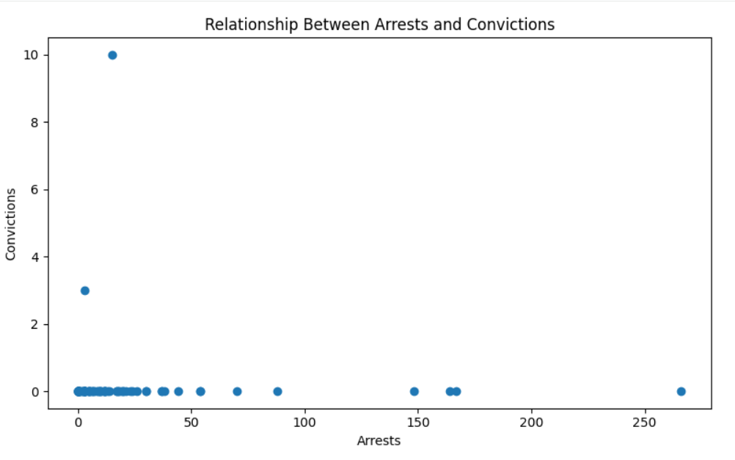
Data Visualization

Slide 14
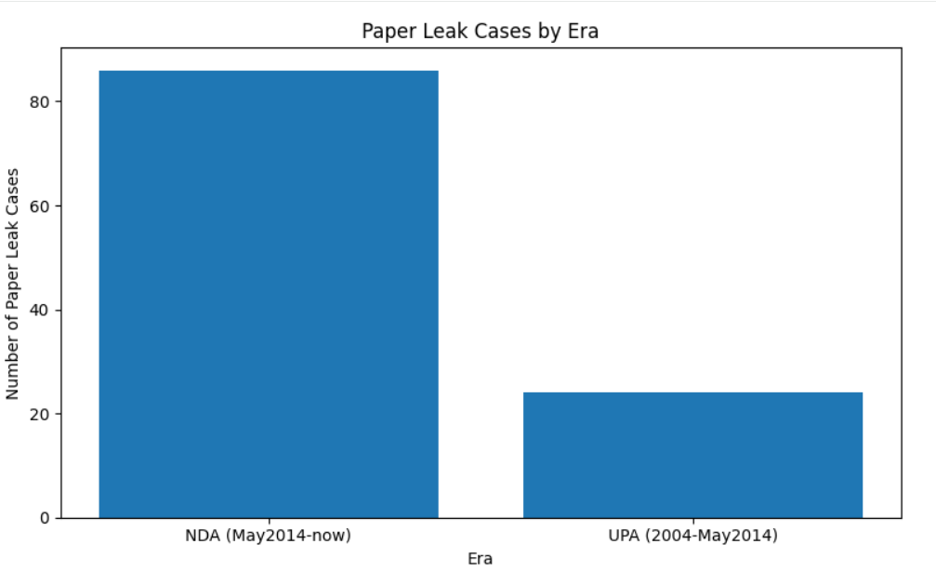
Data Visualization

Slide 15
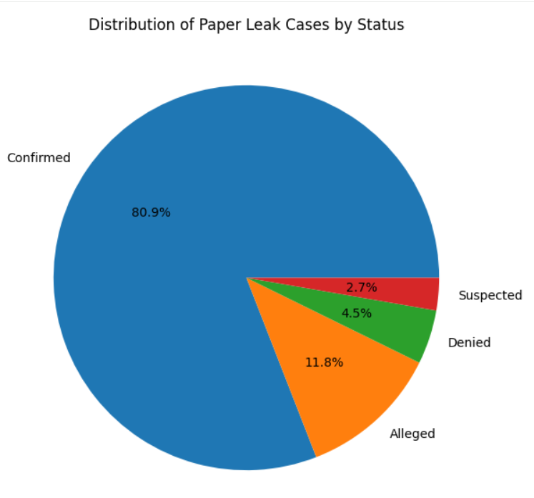
Data Visualization

Slide 16
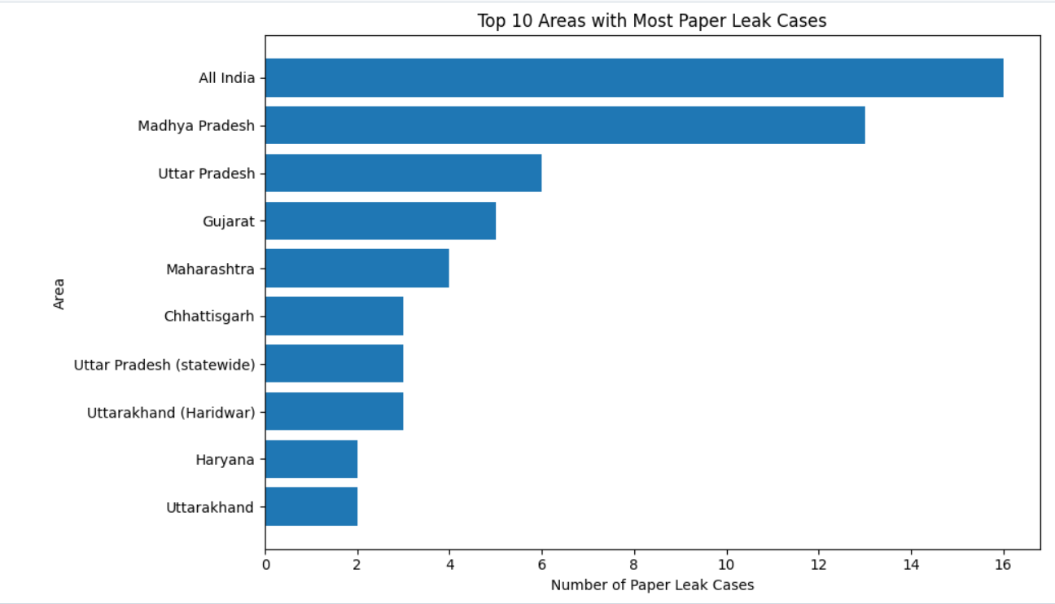
Data Visualization

Slide 17
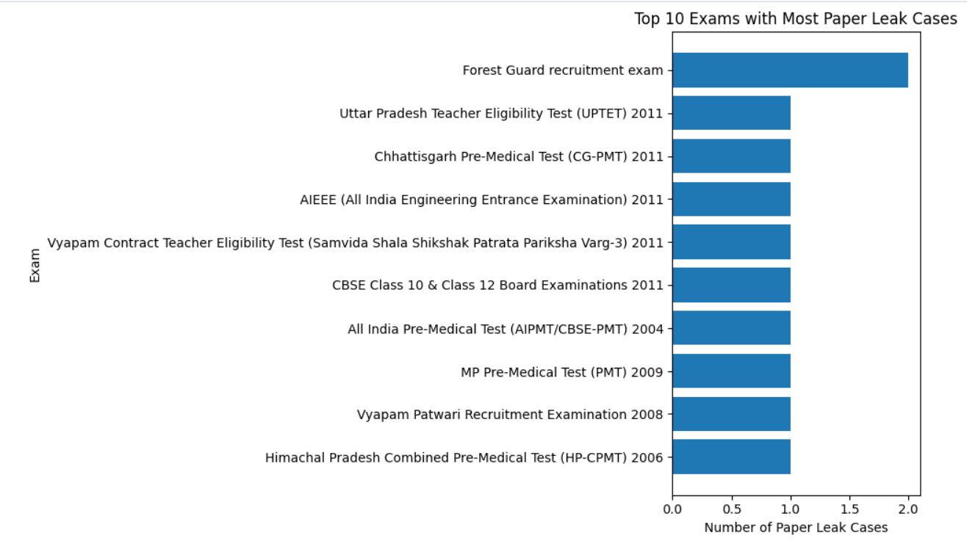
Data Visualization

Slide 18
Key Insights & Analysis
Identifies year-wise paper-leak trends and highest-case periods.
Finds major areas and examinations associated with reported cases.
Compares Confirmed, Alleged, Denied, and Suspected cases.
Compares paper-leak cases across UPA and NDA eras.
Analyzes impact on aspirants, arrests, and convictions.
Uses charts to clearly present patterns, trends, and relationships.

Slide 19
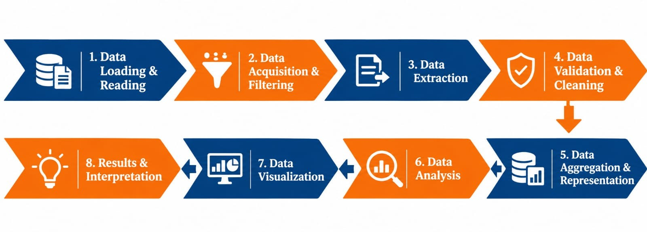
Implementation Workflow
From raw data to actionable insights — adapt these stages to your own project

Slide 20
CONCLUSION
Analyzed Indian paper-leak cases from 2004–2026.
Cleaned and validated the dataset for reliable analysis.
Studied cases by year, area, exam, era, and leak status.
Analyzed the impact through affected aspirants, arrests, and convictions.
Used data visualization to identify and present important patterns and trends clearly
Provides a structured view of paper-leak incidents for better understanding of the data.

Slide 21
THANK YOU

